Slide 1

Optimal Pricing
Of Flights
TEAM: JORDINA ORCAJO, ANGELA ROCA, ALBA CONDE, ROGER BORRÀS
TUTOR: SANTI SEGUÍ

Slide 2
INDEX
1. The Data
2. Descriptive Analysis
3. Pricing Modelization
4. WebScrapping
5. Conclusions
6. Further Steps
7. Resources

Slide 3
THE DATA
Origin : Borrowed dataset from a Student group.
Num. Observations : 73756
Num. Ticket Flights : 2254
Period of Data : from 16/11/2015 to 30/05/2016
Features (16 variables) :
  ID_Ticket
  Origin City
  Destination City
  Airline Company
  Departure Day
  Departure WeekDay
  Departure Time
  Arrival Day
  Arrival WeekDay
  Arrival Time
  Flight Duration
  Pricing
  Type of Demand*
  Days In Advance
  Query Day
  Query WeekDay

Slide 4
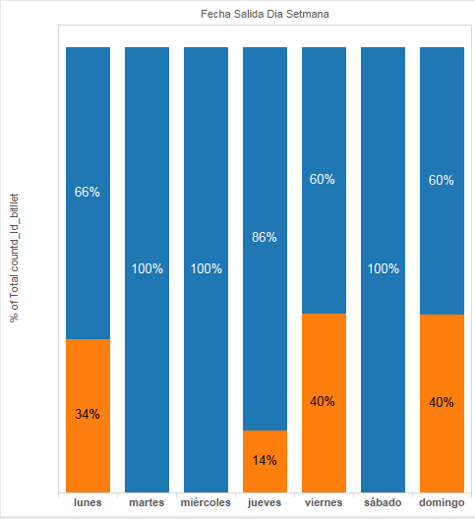
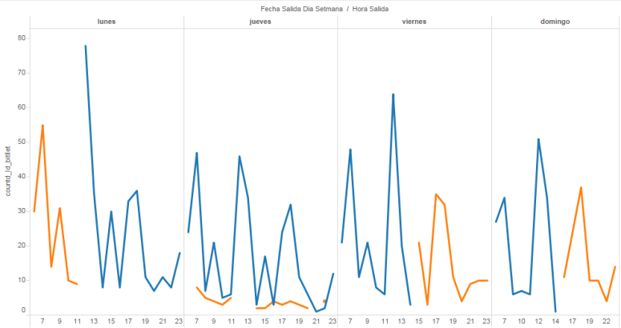
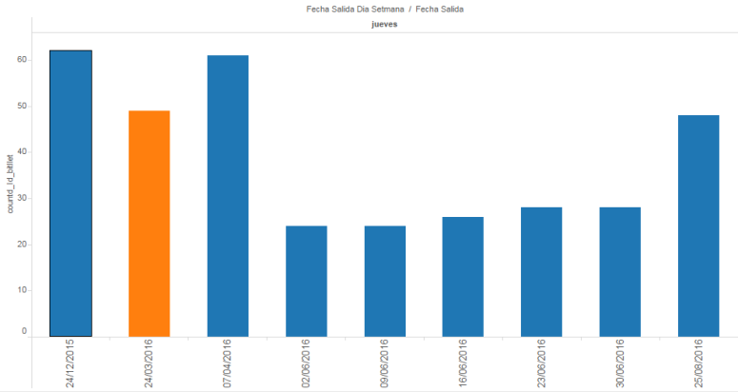
Variable type of demand
  The high demand days are Monday, Thursday, Friday and Sunday.
  The high demand time slots are on Monday morning, Friday afternoon and Sunday afternoon.
  High demand flights are also defined by festivities.

Slide 5
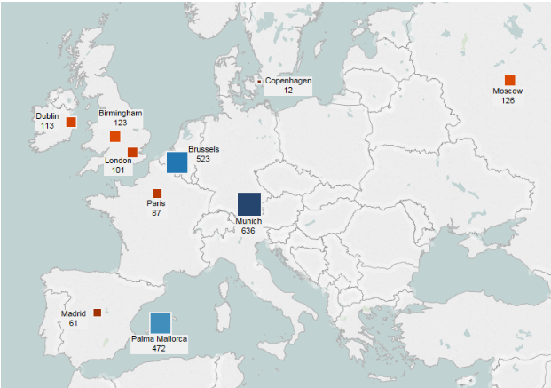
DESCRIPTIVE ANALYSIS
Fig.1 : Destination Map

Slide 6
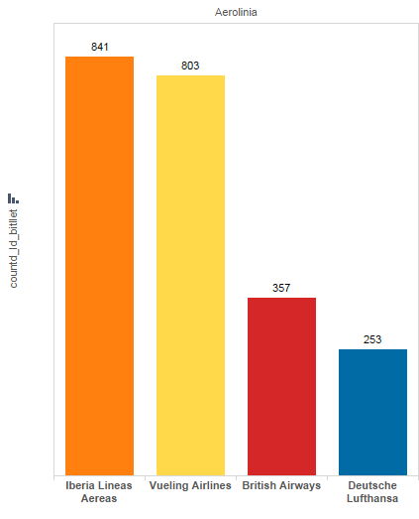
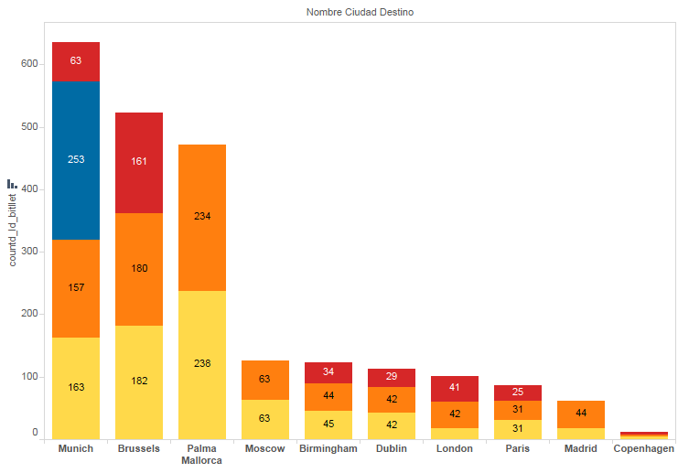
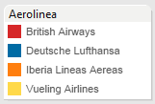
Fig.2 : Tickets by operator
Fig.3 : Destination by operator

Slide 7
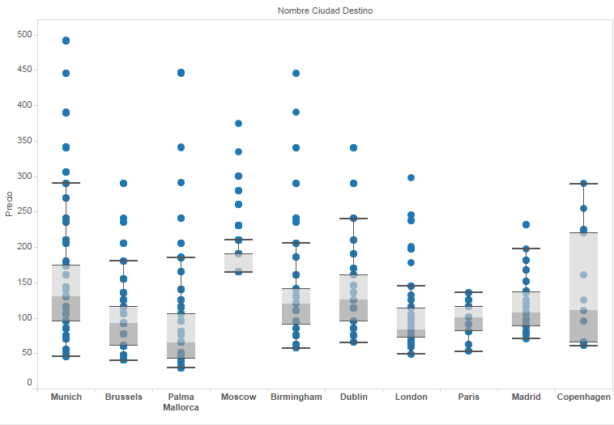
Fig.4 : Pricing distribution by destination

Slide 8
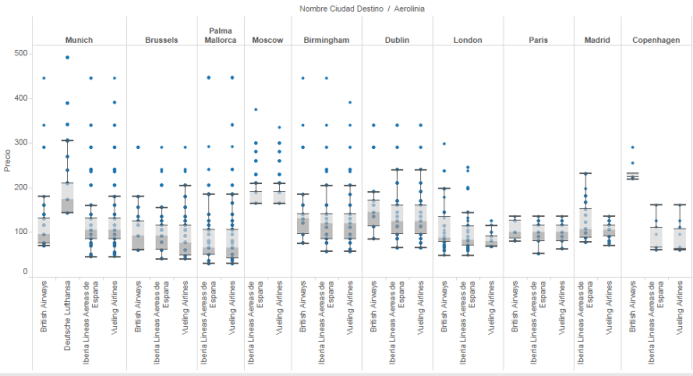
Fig.5 : Pricing distribution by destination and by operator

Slide 9
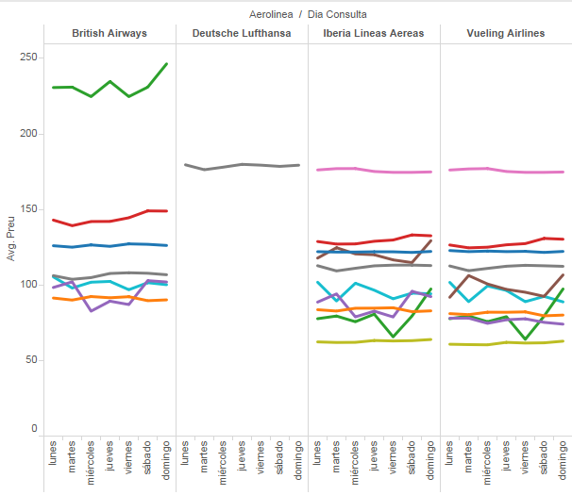
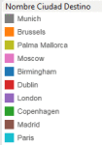
Fig.6 : Average pricing distribution by weekday destination and operator

Slide 10
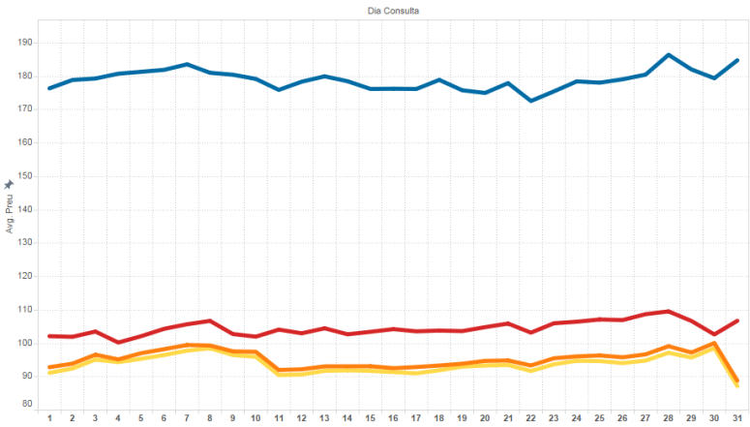
Fig.7 : Average pricing distribution by Buy Date and operator

Slide 11
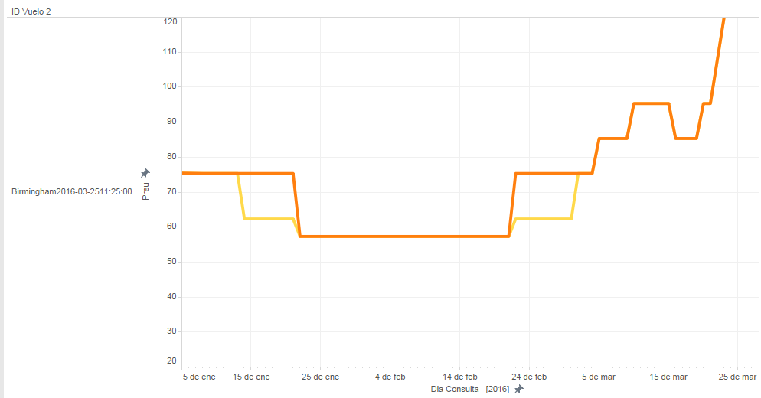
Fig.8 : Pricing evolution by Buy Date and operator of an specific flight

Slide 12
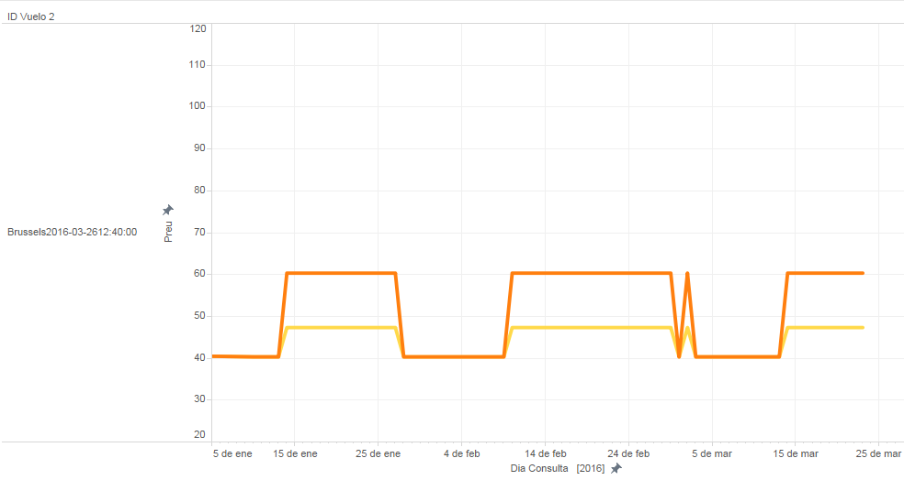
Fig.9 : Pricing evolution by Buy Date and operator of an specific flight

Slide 13
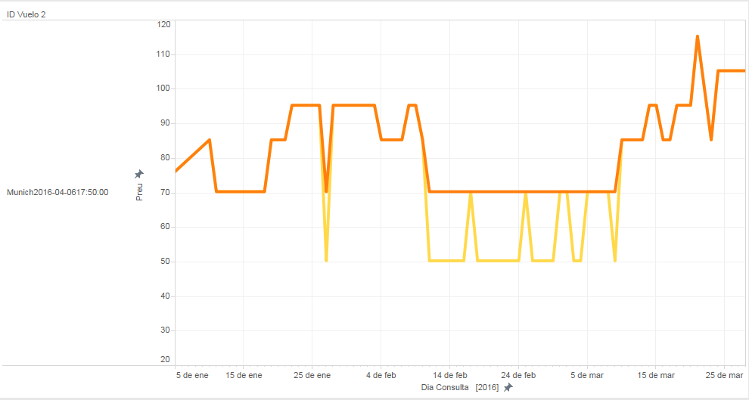
Fig.10 : Pricing evolution by Buy Date and operator of an specific flight

Slide 14
PRICING MODELIZATION:
Objectives
Model pricing fluctuations.
Pricing differences between operators.
Defining purchasing strategies.
Training a ticket pricing prediction model.
Training a classification model to recommend users to purchase the ticket or not.

Slide 15
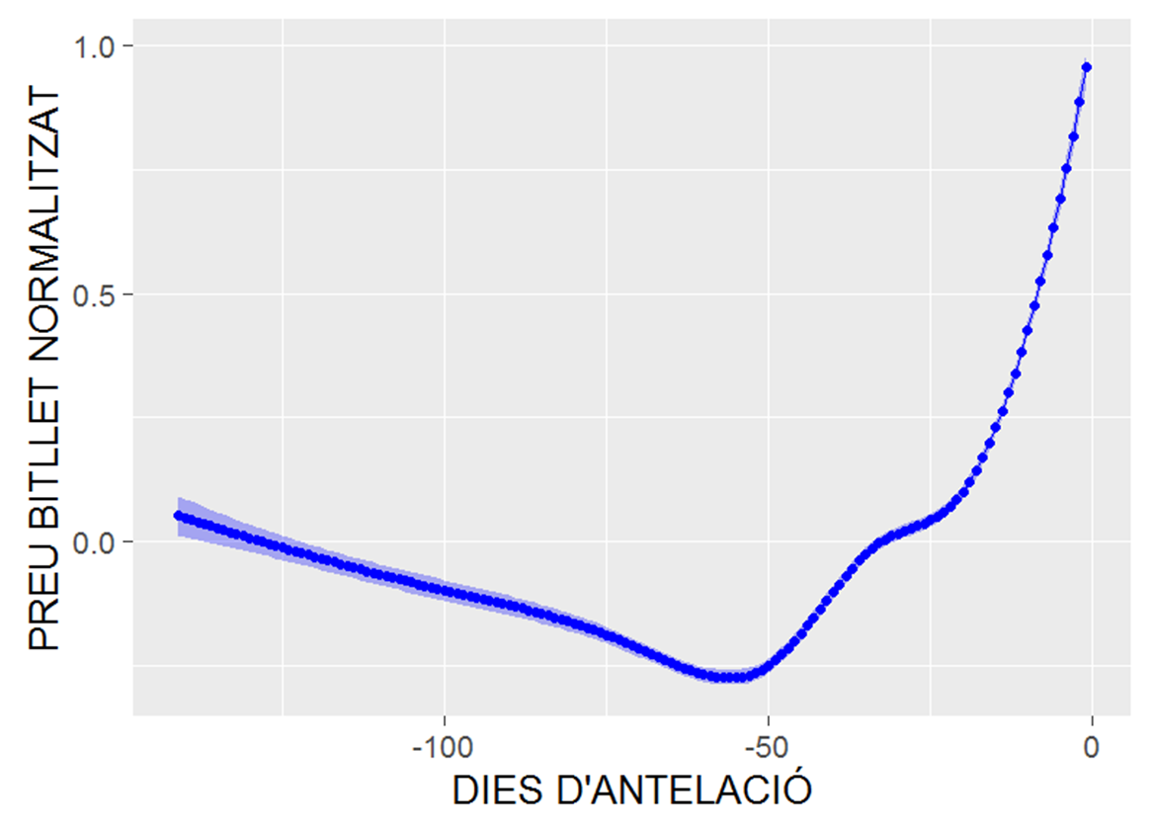
Model Pricing Fluctuations
Fig.11 : Local regression of global pricing fluctuation

Slide 16
Model Pricing Fluctuations
Globally, the prices tend to go down, between five and two months.
The cheapest price is on the 55th day before the departure time (8 weeks left).
If we take a global linear approach, the price increases a 0.18 € per day.
Splitting by time, up to the 55th day before the departure, prices tend to fall 0.03 € per day. From that day, the rise is 0.42 € per day.

Slide 17
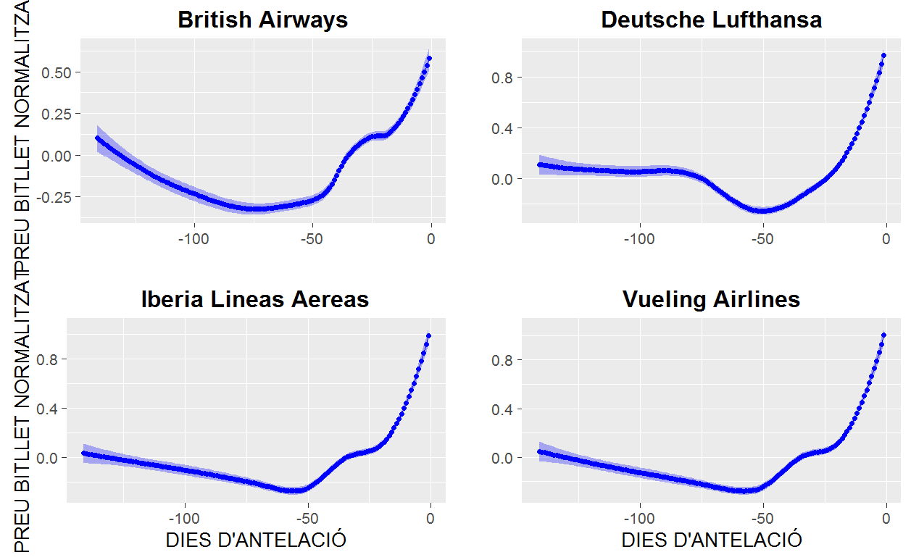
Pricing Differences between operators
Fig.12 : Local regression of global pricing fluctuation by operator

Slide 18
Purchaising strategies
The cheapest day to fly is Wednesday (90 € on average). On Sunday is the most expensive and worth 40 €.
To buy tickets, the best day is Tuesday. And the worst is Sunday worth 4 €.
The days of high demand the prices are 18 € higher.
Training a Ticket Pricing Prediction Model
We train a model to predict the price, with the:
  day of departure
  day of purchase
  the days ahead
  we obtained an R² of 0.57.
  the demand type (high/low)
  the company
  the city of destination

Slide 19
Recommender
Our recommender will suggest to buy or not to buy.
We create an output variable which tell us if the price will decrease or increase in the future.
We apply different methods with 10-fold cross-validation.

Slide 20
(?)RECOMMENDER - different models
Different accuracy/standard desviation for each model:
  Logistic regression
  Cart
  Random Forest
  Stochastic Gradient Boosting

Slide 21
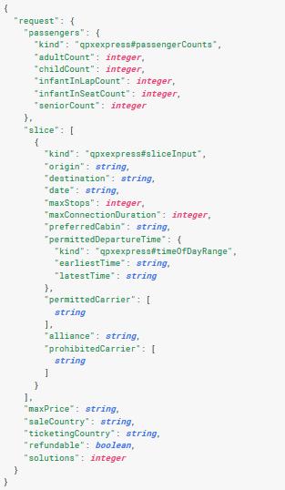
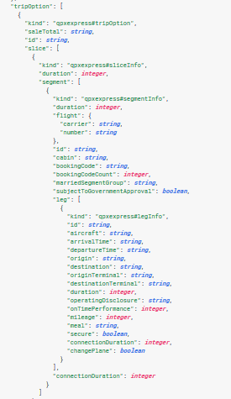
SCRAPPING
API Google Flights (https://www.google.es/flights/)
RESPONSE
REQUEST

Slide 22
SCRAPPING
Automatic program to scrap data from Google Flights.
Aim : Recollect new data for future steps.

Slide 23
CONCLUSIONS
Iberia and Vueling have a very similar pack of flights.
Their prices are often different.
Travelling to Munich with Lufthansa is the most expensive price.
Destí/Compañia més variable
The price to buy depends more of the weekday than the part of the month.
The cheapest day to buy tickets is Tuesday, 4 € less than Sunday which is the most expensive.
The best period to buy a ticket is 8 week before the departure day. (intentar conseguir un porcentaje)

Slide 24
FURTHER STEPS
Validation of the recommender with new datasets.
Models improvement including more training data.
Historic data to find patterns (seasonality, etc)
Finding the reasons why the strategy of Vueling is cheaper than the Iberia one.

Slide 25
SIMULATION
Un vol que surt el dia 15 divendres, 7.10 AM – MUNICH
Dia de la query : 10/07 (PREU = 75e)
fecha_salida_dia_setmana = viernes
dia_query_dia_setmana = diumenge
dias_antelacion= 5
nombre_ciudad_destino =Munich
Aerolinia= Vueling
Duracion= 2h 05 min
Demanda= No
Volem la diferencia entre el preu esperat/real. I veure com funciona el recomandar?

Slide 26
RESOURCES
Link del GITHUB
Link del BLOC
Tools:
  R Studio : Per al tractament de dades.
  Sypder :
  Wordpress :
  Tableu :
  Ordenar los tools y explicar en qué se han usado por encima.

